Slide 1
Hosting a Free Website using HOSTINGER

Slide 2
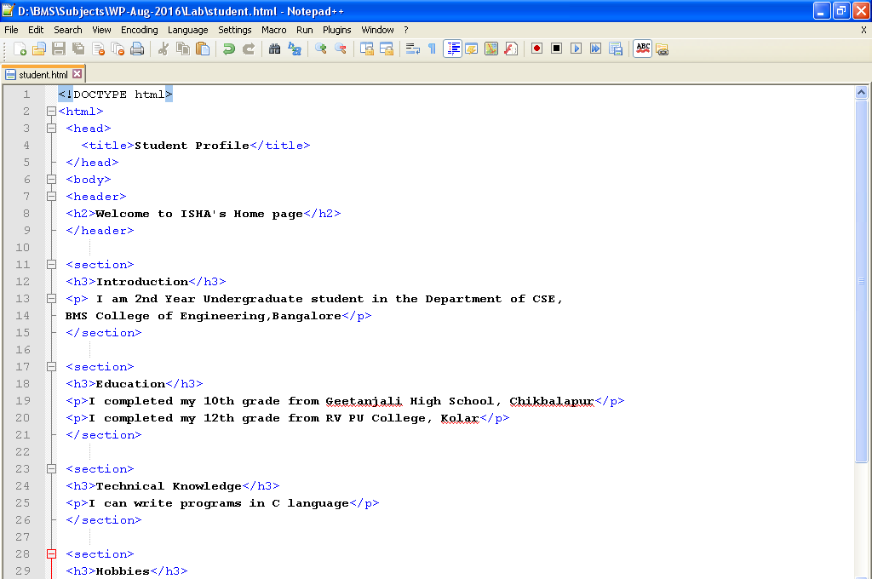
Creating Student Profile Page
Open the file student.html in the Notepad++ Editor on your computer system.

Slide 3
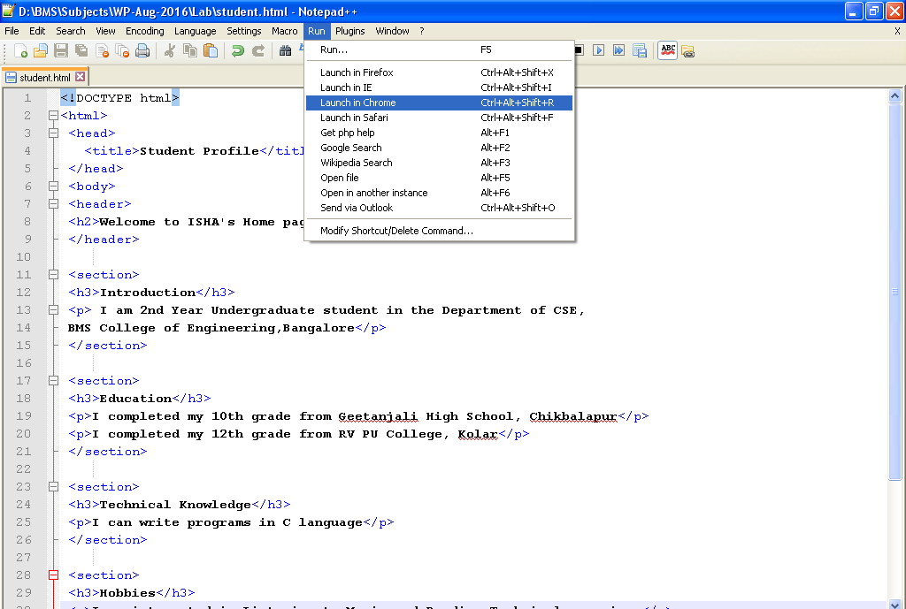
Run student.html file through browser
Click on RUN menu item in the editor and launch in Chrome
Click on RUN
and
Select
Launch in Chrome

Slide 4
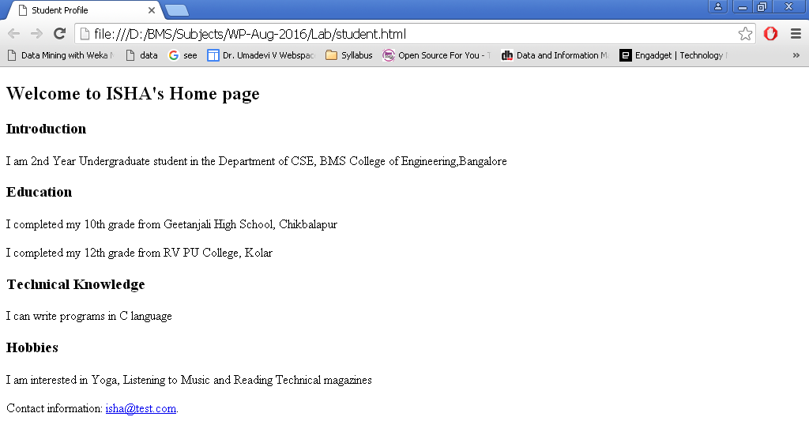
Output on the Web Browser

Slide 5
Edit details in student.html file as per Yours and save the file

Slide 6
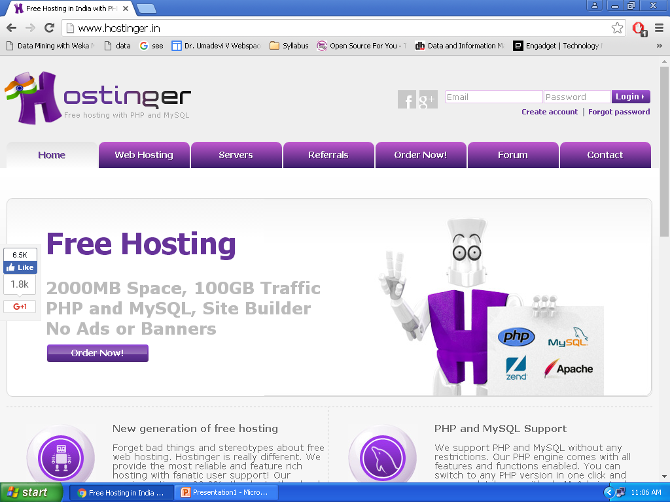
Open your Browser and type the URL http://www.hostinger.in/

Slide 7
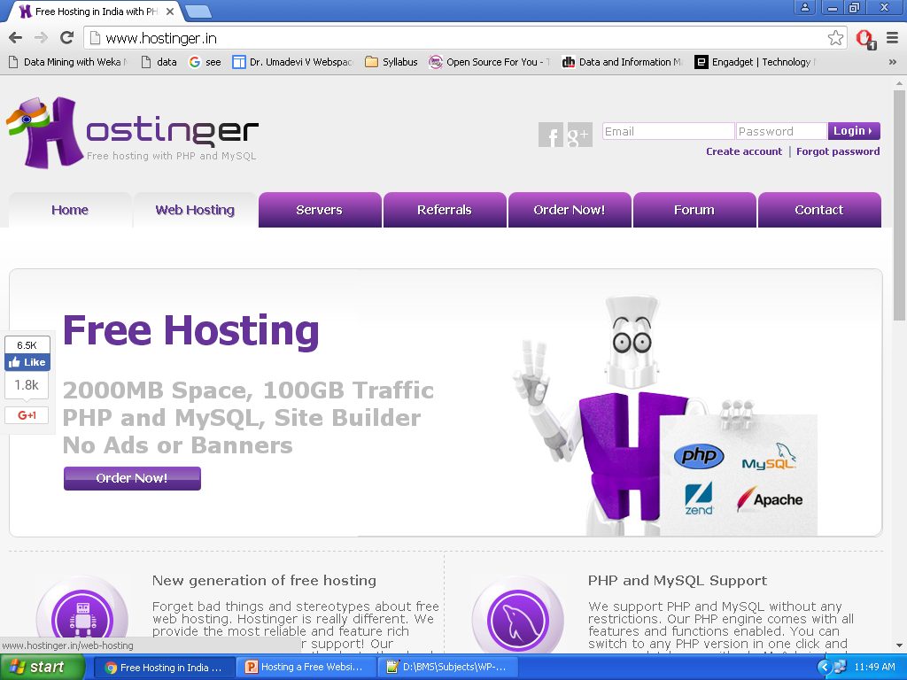
Click on Web Hosting
Click on
Web Hosting

Slide 8
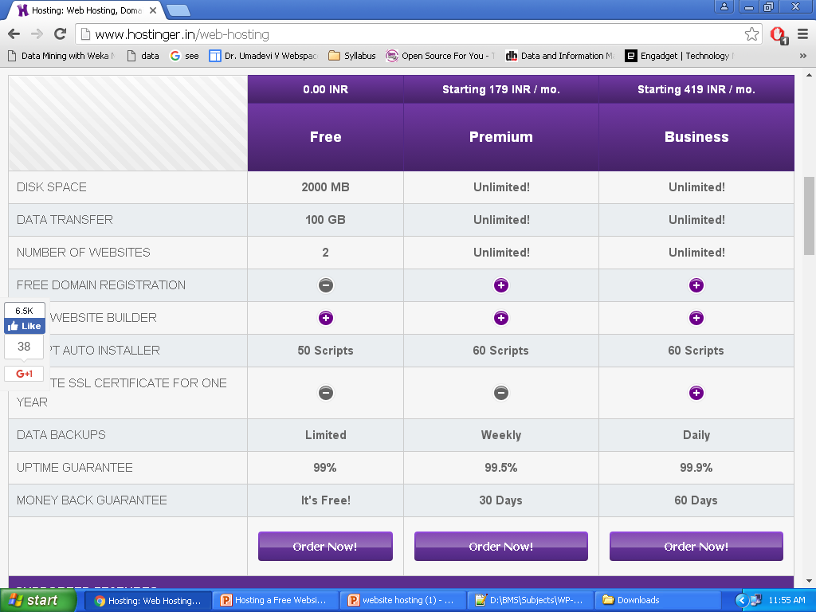
Scroll down and click on “ordernow” under the free section
Click on
Order Now

Slide 9
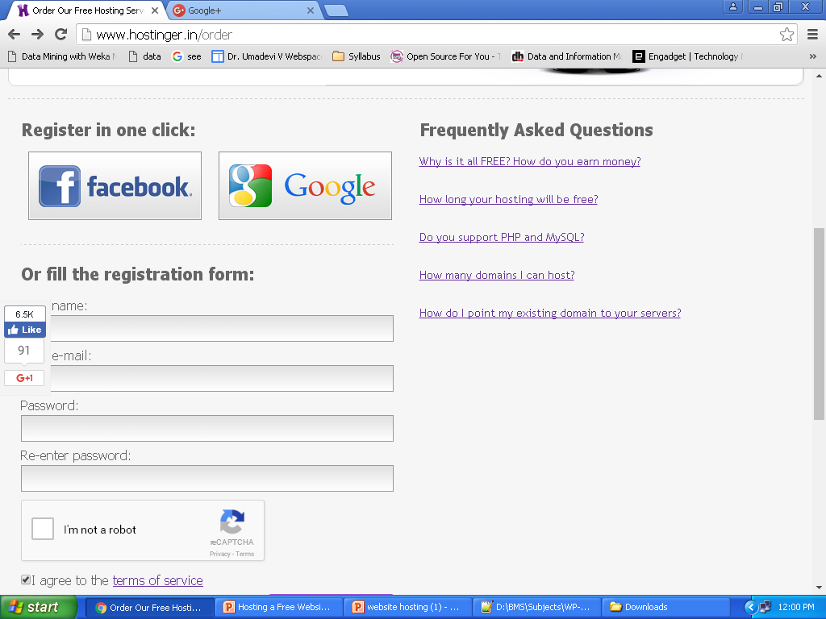
Scroll Down and Select “Register one Click” Google
Click And
Enter Your
Gmail Account
details

Slide 10
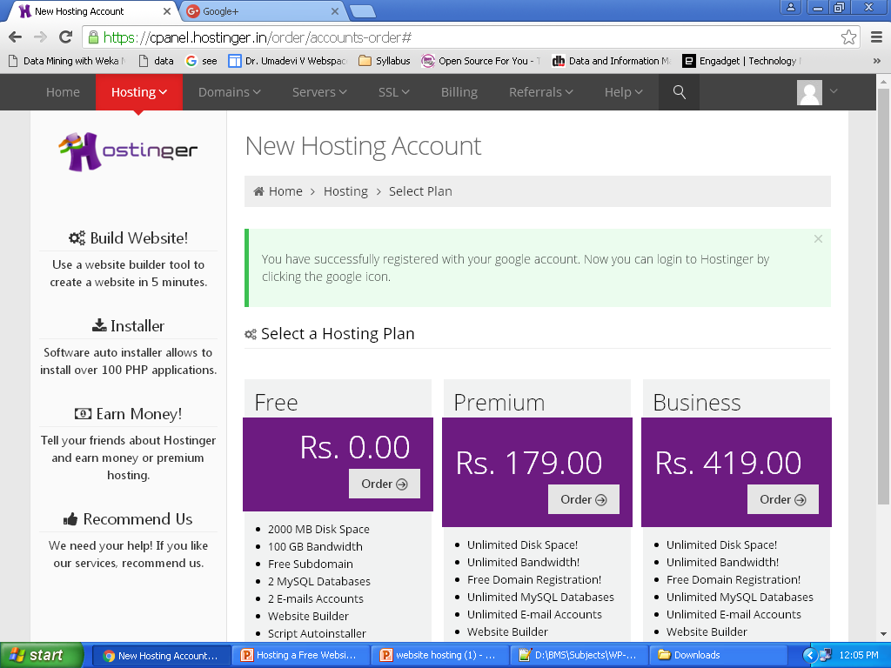
Now Your Account on Hostinger has been Created

Slide 11
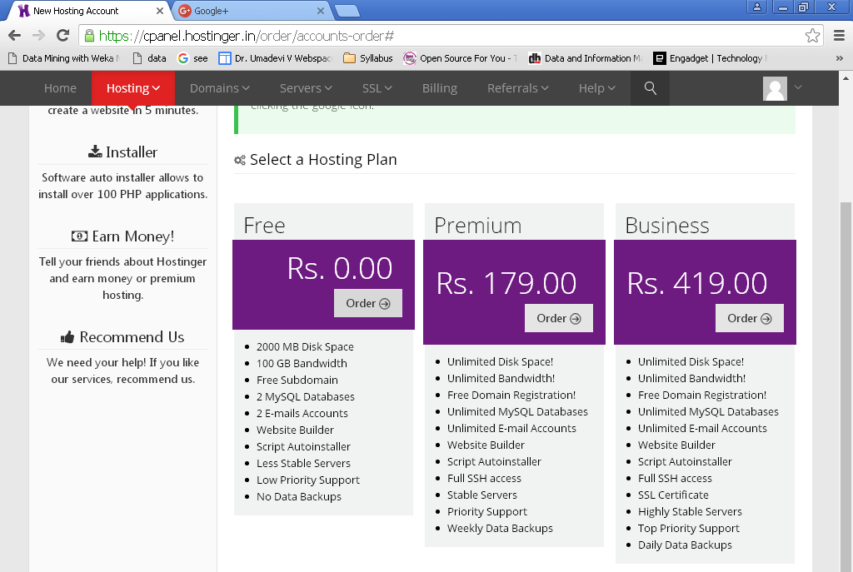
Scroll Down and Select under Free plan “Order Now”
Click on
Order

Slide 12
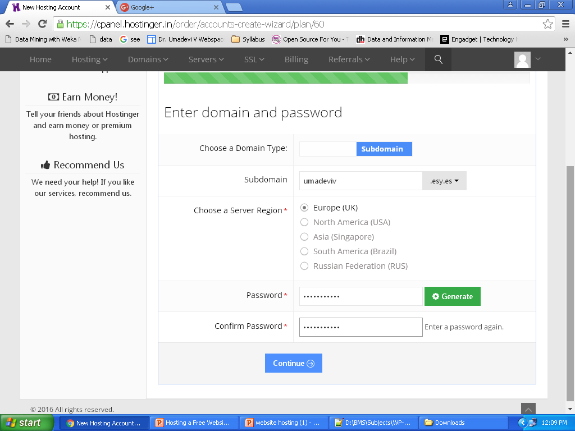
Enter Sub domain name and password. Click on Continue.

Slide 13
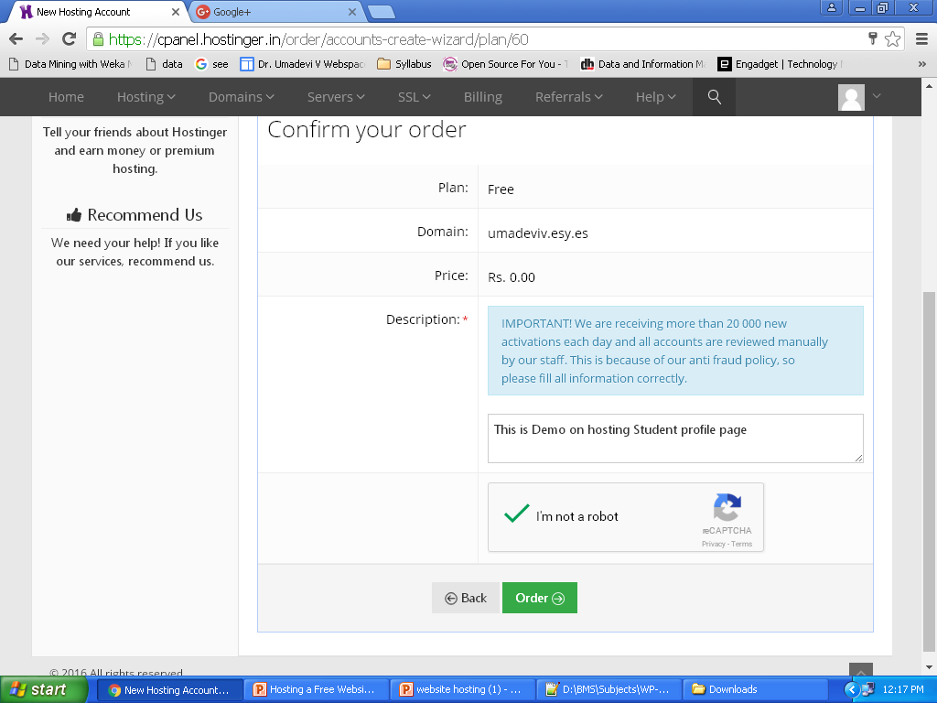
Enter Description; Check “ I am Not a robot” ; Click Order
This is Demo on
hosting Student
profile page
Check
Click “Order”

Slide 14
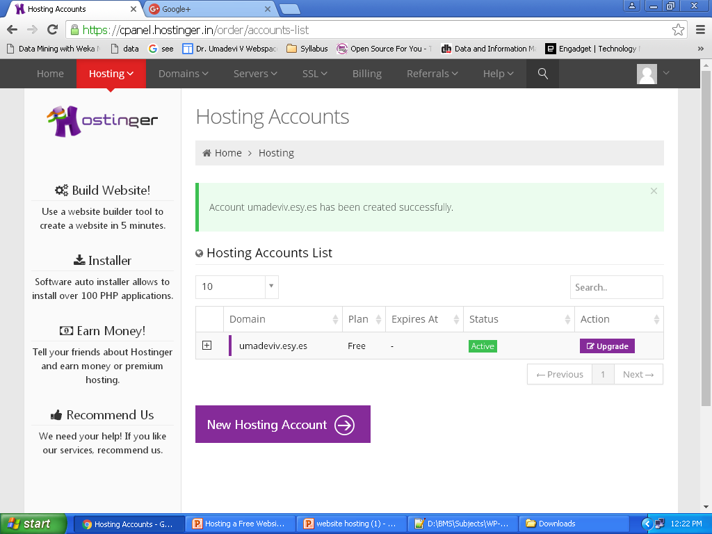
Now Click on domain name
Click

Slide 15
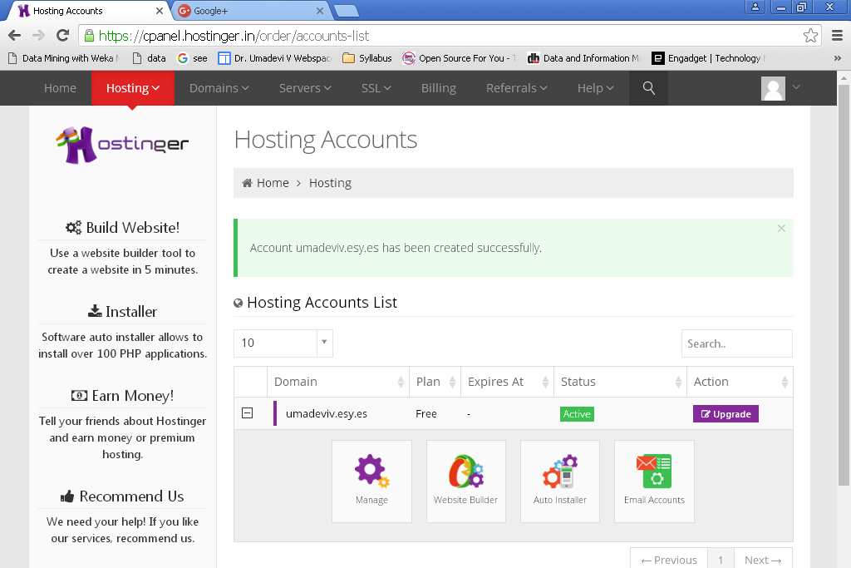
Click on “Manage”
Click on
Manage

Slide 16
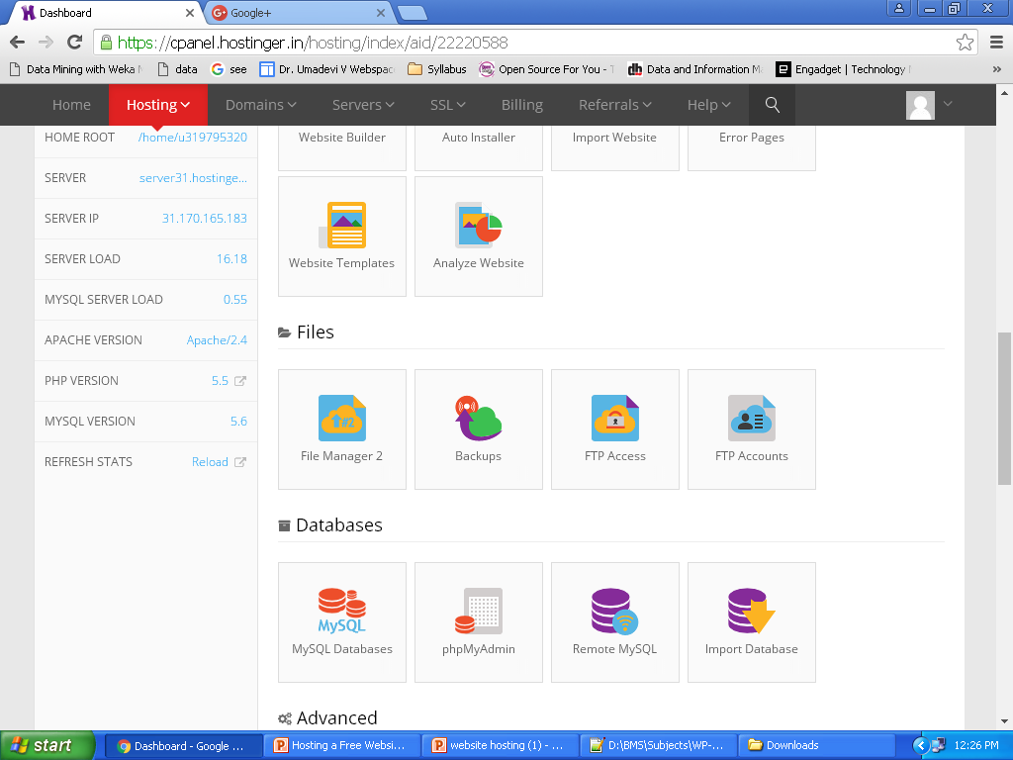
Scroll Down and Select “File Manager 2”
Click on
File
Manager 2

Slide 17
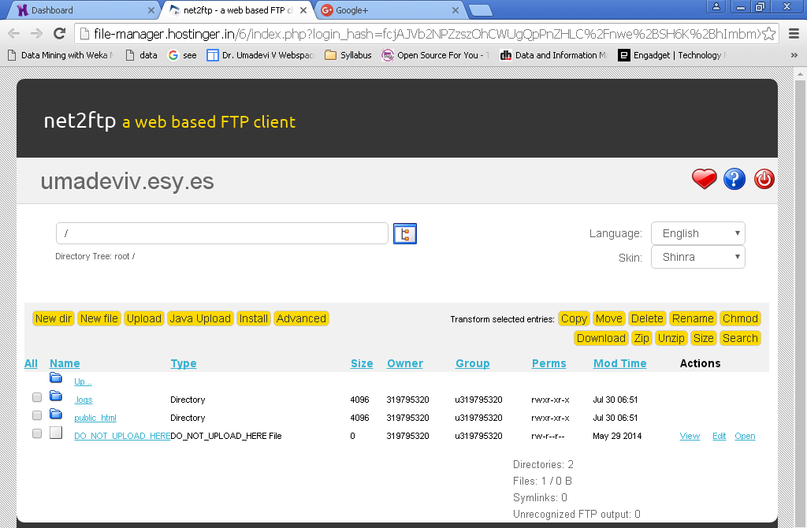
Click on “public_html”
Click on
public_html

Slide 18
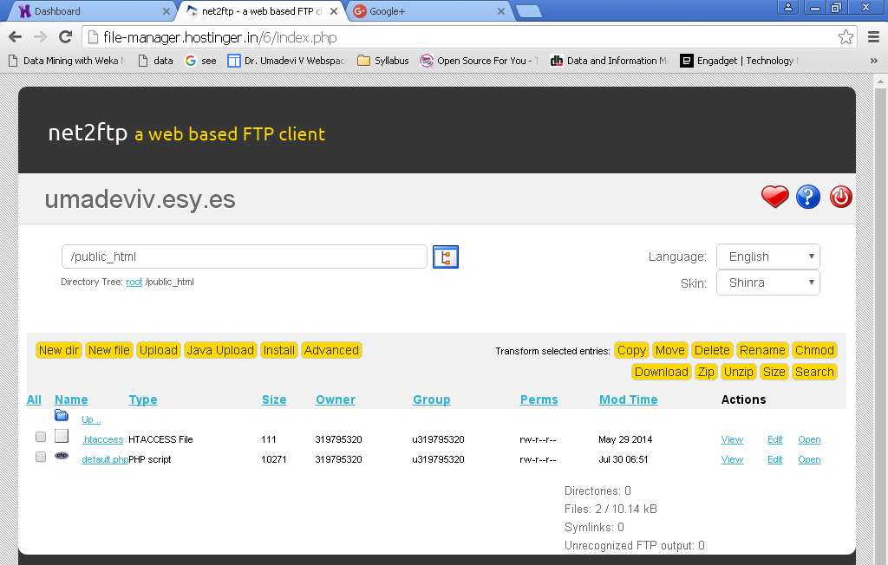
Click on “Upload”
Click
On
Upload

Slide 19
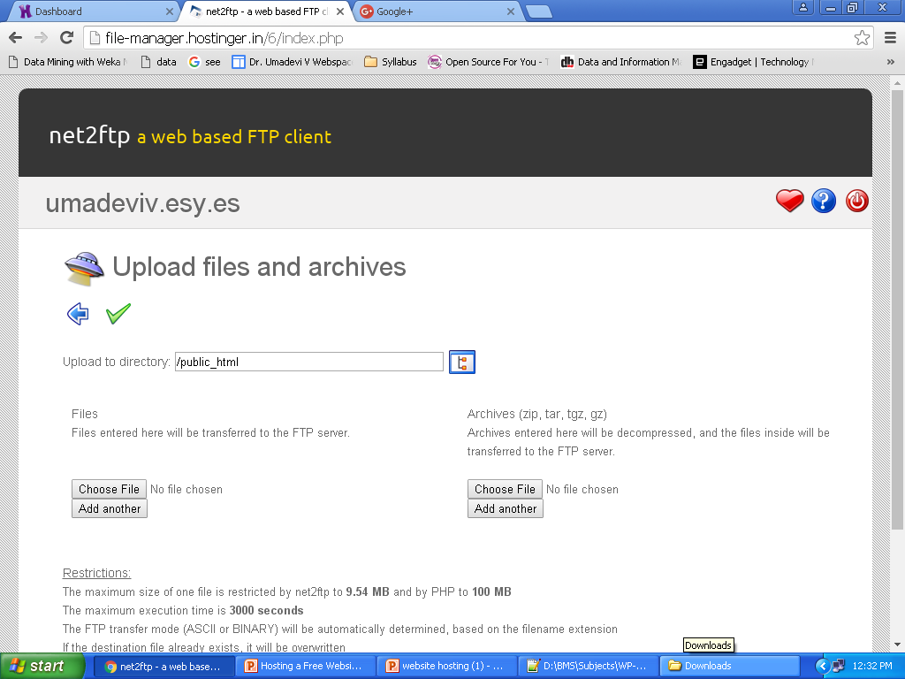
Click on “Choose File”
Click on
Choose file

Slide 20
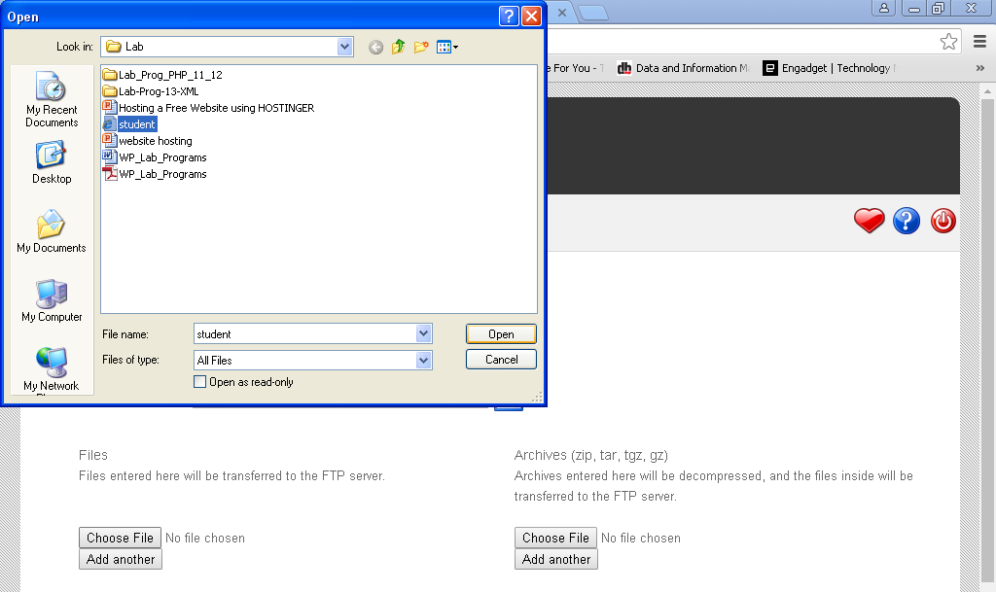
Select the file “student.html” and click on Open

Slide 21
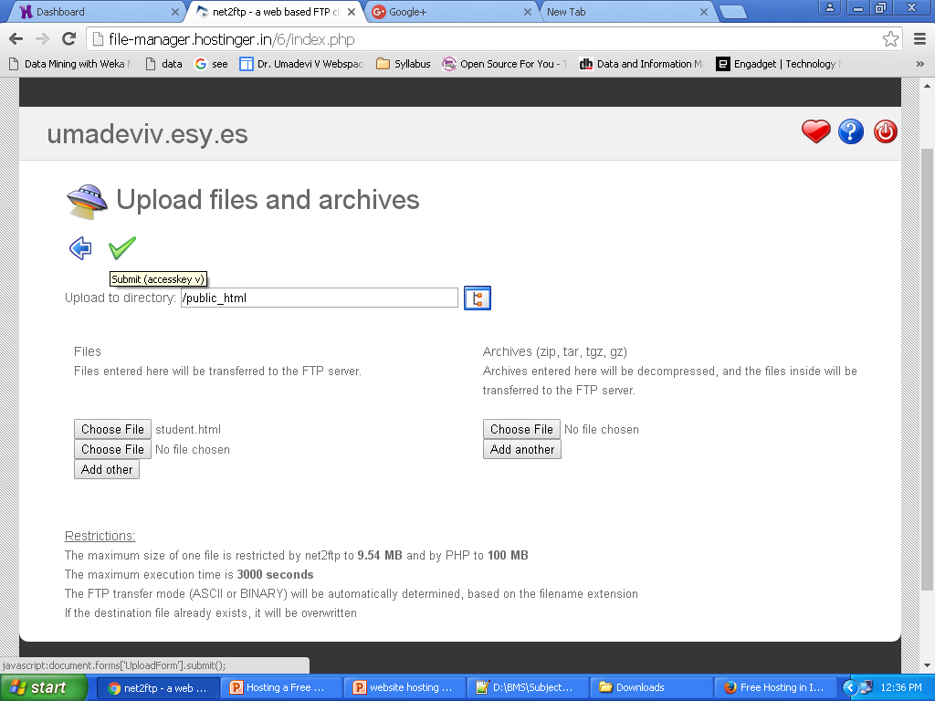
Click on “Submit”
Click on
Submit

Slide 22
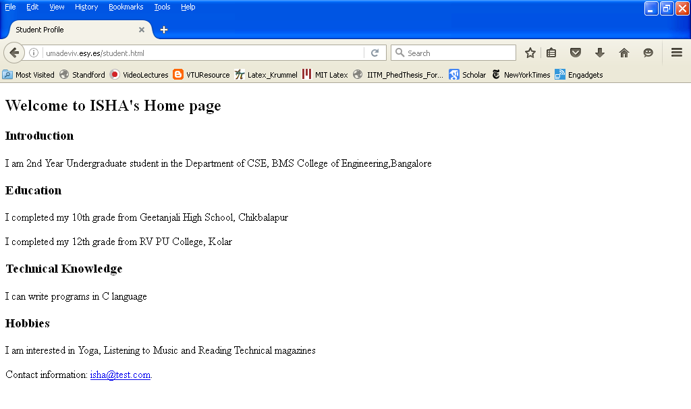
Open Web browser and type the URL “your_domain_name.esy.es/student.html” Example: umadeviv.esy.es/student.html

Slide 23
Congratulations………
Now You Have Successfully Launched your webpage on Hostinger.
Note: LOGOUT from Hostinger account

